Slide 1


Health Hub:Personalised Wellness Management
Team Members Registration Numbers
1.M.Padmavathi 202P1A0578 Under the Guidance of
2.P.Gouthami 202P1A05A0 Y.D.Rami Reddy,Ph.D
3.P.Poojitha 202P1A05A3 Professor
4.N.Divya Sree 202P1A0585
5.R.Pravya Sree 202P1A05B1
Department of Computer Science and Engineering
CHAITANYA BHARATHI INSTITUTE OF TECHNOLOGY
(Affiliated to JNTUA, Approved by AICTE, Accredited by NAAC with ‘A’ Grade & Accredited by NBA (B.Tech CE, EEE, ECE & CSE))

Slide 2
Agenda
Introduction
Objectives
Abstract
Existing System
Existing System Disadvantages
Proposed System
Proposed System Advantages
Hardware Requirements
Software Requirements
Architecture
Conclusion

Slide 3
Introduction A health hub that specializes in personalized wellness management offers individuals a unique opportunity to take control of their health and wellness in a tailored and comprehensive manner. By focusing on each person's distinct needs, goals, and lifestyle, the health hub delivers customized solutions that promote overall well-being and improve quality of life.the health hub's mission is to empower individuals to lead healthier, happier lives through personalized wellness management and a strong support network. By prioritizing individual needs and outcomes, the health hub aims to create sustainable, positive changes in the lives of its users.

Slide 4
Objectives The objective for a health hub that offers personalized wellness management is to empower individuals to take control of their health and wellness by providing customized, evidence-based guidance and support. This approach aims to optimize overall well-being through tailored strategies that account for an individual's unique health profile, goals, and lifestyle. Key objectives include: Holistic Health Assessment: Conduct comprehensive evaluations to understand the individual's current health status, including medical history, lifestyle factors, and personal goals. Personalized Plans: Create customized wellness plans based on each individual's assessment, focusing on nutrition, physical activity, mental health, sleep, and other factors. Continuous Monitoring: Implement ongoing monitoring and data collection to track progress and make adjustments to the wellness plan as needed.

Slide 5
Abstract Abstract This abstract outlines the design and implementation of a comprehensive Personalized Wellness Management (PWM) project within a health hub framework. The project aims to revolutionize healthcare delivery by leveraging advanced technologies and personalized approaches to optimize individual wellness. Through the integration of data analytics, wearable devices, and user-centric platforms, the PWM project seeks to empower individuals to take proactive steps towards improving their health and well-being.

Slide 6
Existing System
A health hub serves as a centralized platform offering integrated healthcare services, digital health technologies, and patient-centered care. With a multi-disciplinary team of professionals, it provides comprehensive care, promotes health education, and collaborates with community resources. Through population health management and quality improvement initiatives, it aims to ensure accessibility and affordability, striving to enhance the well-being of individuals and communities.

Slide 7
Existing System Disadvantages
Reliability and Accuracy
Overreliance on Technology
Loss of Personal Connection
Cost
Data Security Risks
Privacy Concerns

Slide 8
Proposed System Many individuals struggle with maintaining a healthy lifestyle due to a lack of guidance and personalized plans. Health Hub addresses this challenge by creating a comprehensive platform that combines fitness tracking, nutritional advice, and community support, empowering users to take control of their health and well-being. Features
Personalised Health Plans
Fitness Activity Tracker
Nutritional Database
Appointment Scheduler
Water Intake Monitor
Sleep Quality Tracker

Slide 9
Proposed System Advantages
Improved Health Behaviours
Reduces Stress
Control Chronic Risks
Health awareness
Continuous Monitoring and feedback
Efficiency
Empowerment
Preventive Care

Slide 10
Hardware Requirements
RAM: 4gb(or) Advanced
Hard Disk: HDD(or) SSD-128gb
Processor: Intel Core

Slide 11
Software Requirements
OS: Windows 10/11
Languages:
Front-End: Html, CSS, Java Script and Boot Strap
Back-End: Nodejs
Database: Mongo db
Tools: VS Code, Chrome

Slide 12
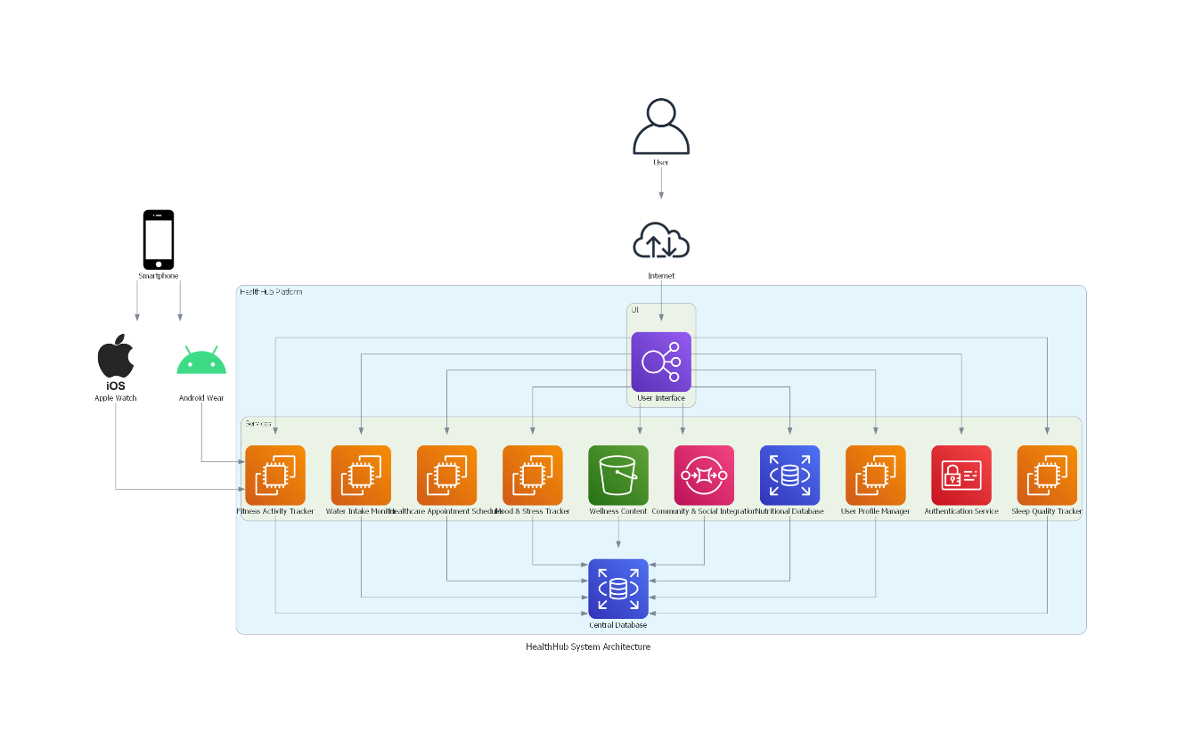
System Architecture

Slide 13
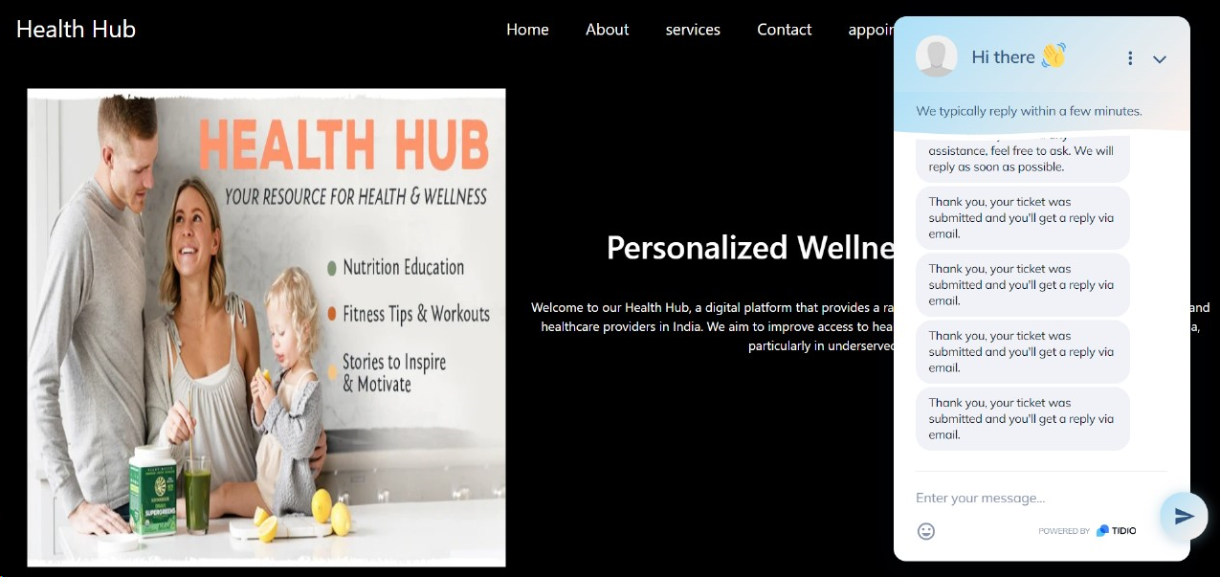
Results

Slide 14


Slide 15
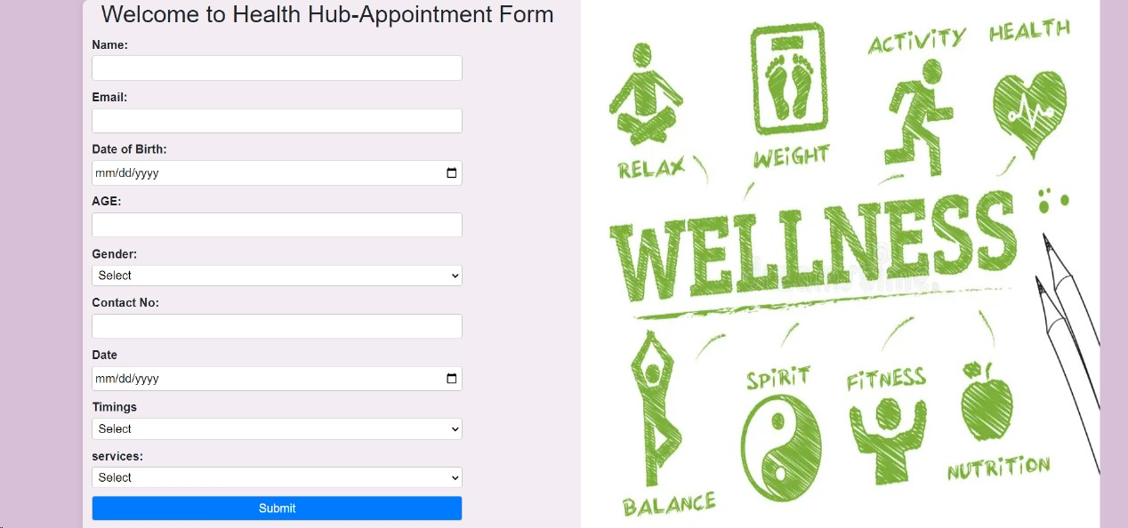

Slide 16


Slide 17
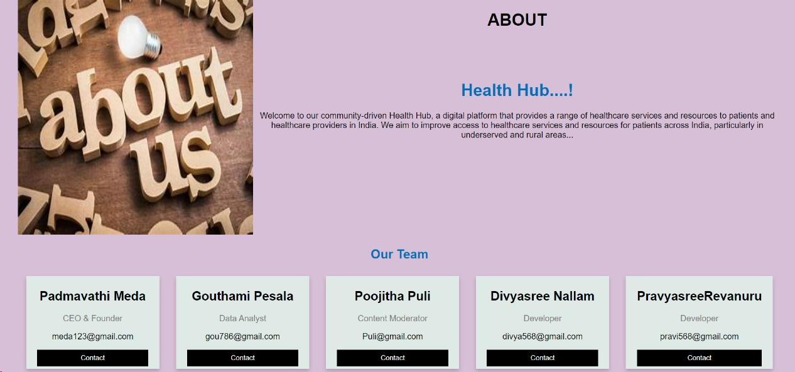

Slide 18


Slide 19
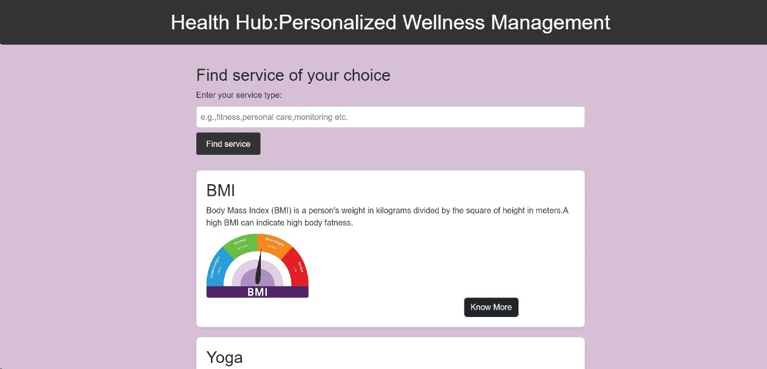

Slide 20
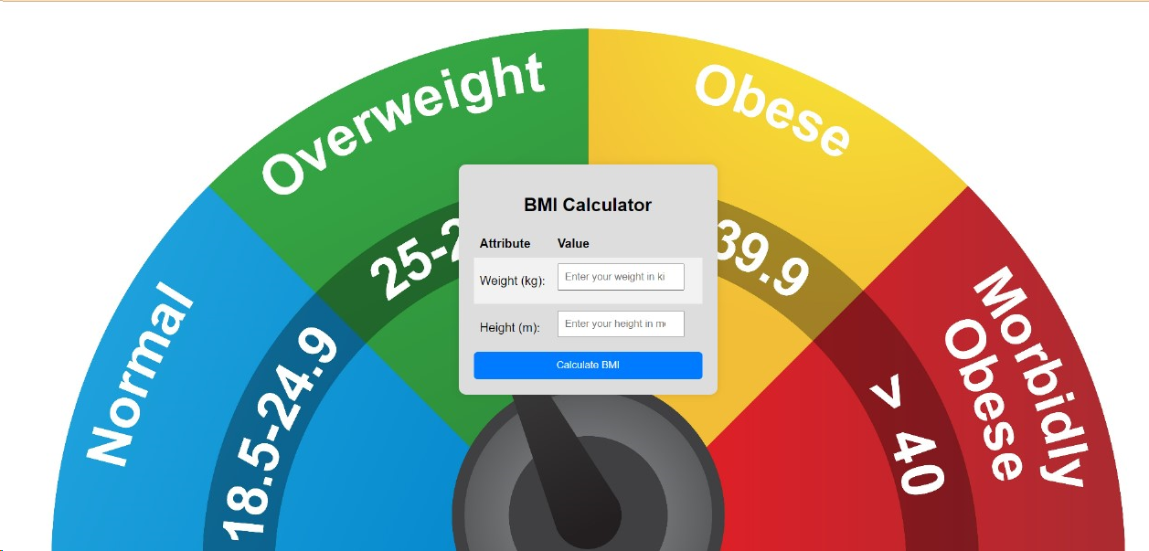

Slide 21
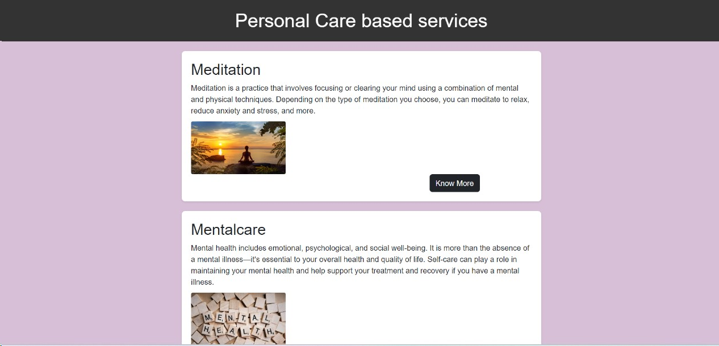

Slide 22


Slide 23


Slide 24
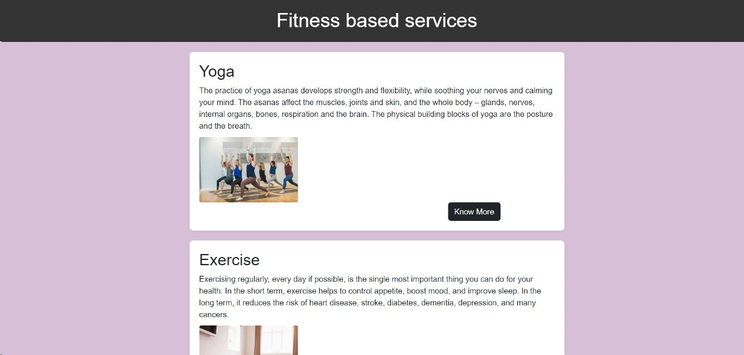

Slide 25


Slide 26


Slide 27


Slide 28
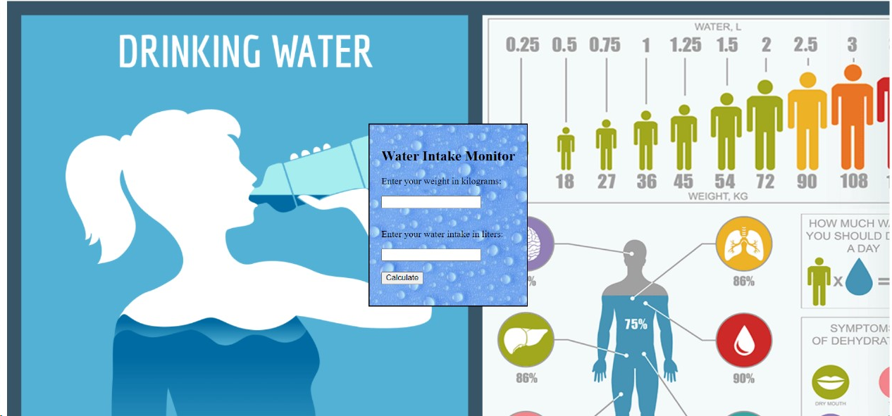

Slide 29


Slide 30
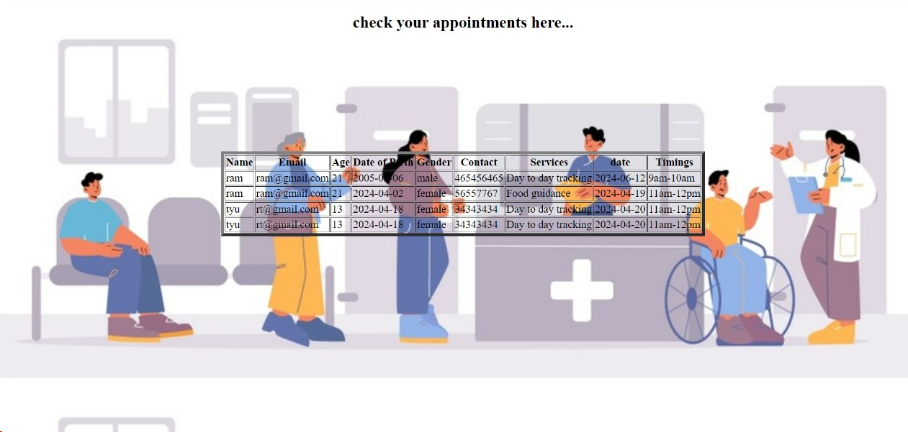

Slide 31
Conclusion
With its innovative features and personalized approach to wellness management, Health Hub is poised to revolutionize the way individuals take care of their health. Whether you're looking to lose weight, increase your fitness level, or simply lead a healthier lifestyle, Health Hub provides the tools, resources, and support you need to achieve your goals and live your best life. Overall, a health hub project centered on personalized wellness management has the potential to transform healthcare delivery, promote individual empowerment, and enhance population health outcomes. By integrating the right mix of software and hardware components, adhering to regulatory requirements, and prioritizing patient-centered care, such a project can pave the way for a healthier and more connected future.

Slide 32


